Slide 1

Developing Canada’s Helium Resources
Corporate Presentation
February 2025
TSXV : HEVI

Slide 2

Reader Notice
Forward-looking Statements
Certain statements contained in this corporate presentation may constitute forward-looking information and statements, including "future-oriented financial information" and "financial outlook", under applicable securities laws. All statements in this corporate presentation, other than statements of historical fact that address events or developments concerning Helium Evolution Incorporated (hereinafter referred to as the "Company" and "HEVI") that the Company expects to occur are "forward-looking information and statements". Forward-looking information and statements are often, but not always, identified by the use of words such as "anticipate", "plan", "estimate", "execute", "expect", "future", "will", "project", "present", "propose", "potential", "target", "trajectory", "begin", "complete", and "finalize", and similar expressions and variations (including negative variations). The forward-looking statements and information are based on certain key expectations and assumptions made by the Company.
In particular, but without limiting the foregoing, this corporate presentation may contain forward-looking information and statements pertaining to the following: the Company’s and North American Helium Inc.’s (“NAH”) future drilling targets (the "Targets"), the Company's business prospects or opportunities, including information concerning potential technologies, products, services and strategies the Company is pursuing; the accumulation of seismic data; the results of interpreting seismic data; capital commitment; market trends and size of market projections with respect to commodity supply and demand generally and in regard to specific regions; other economic projections including commodity price, production, costs, helium concentration, royalties and well life; the projection of commercial production and helium sales in 2025; obtaining all of the required governmental, regulatory, and board approvals and any other additional approvals in connection with the Targets and the proposed business and financing strategy; timing of completion and testing of wells mentioned herein; the Company and NAH’s plans regarding the drilling of the up to 9 joint wells in the Mankota area and locations/drilling on HEVI’s 100% held lands, as described herein; the timing of and increase of yields through the stimulation of wells; reservoir and future Targets; productivity of wells; chance of success for future drills; the number of new drilling Targets; the Company’s drilling plans and timing and success thereof; NAH’s exploration, drilling and completion plans, including the timing and success thereof; the ability of the Company to generate cash flow; the Company / NAH’s plans for building a facility and the timing thereof; NAH’s and/or the Company’s drilling of development wells; future helium pricing; the performance of the Company's business and operations; the intention to grow the business and operations of the Company; the financial success of the Company's commercial arrangements; future liquidity and financial capacity; expectations regarding the Company's ability to raise capital; and projected costs associated with the planned business activities.
The forward-looking statements and information are based on certain key expectations and assumptions concerning the Company's ability to (i) complete future capital raising activities and (ii) to execute on the Company drilling programs/joint drilling program with NAH. Although the Company believes that the expectations and assumptions on which such forward-looking statements and information are based to be reasonable, readers are cautioned not to place undue reliance on forward-looking statements, as there can be no assurance that the plans, intentions or expectations upon which they are based will occur. Since forward-looking statements and information address future events and conditions, by their very nature they involve inherent risks and uncertainties.
Actual results could differ materially from those currently anticipated due to a number of factors and risks. Such factors may include the Company not being able to complete its capital raising activities, the Company and/or NAH not being able to complete its planned capital and drilling programs, the Company/NAH not being able to build a helium facility, the Company not being able to obtain required regulatory and/or governmental approvals for any desired operational activities, operating and capital costs, royalty rates, changes in regulatory policy and compliance requirements, changes in industry conditions, changes in economic conditions in and around target market areas, market and consumer demand for helium, labour and/or equipment shortages, delays or changes in plans with respect to planned capital expenditures, the Company and/or NAH may determine not to bring wells onto production, the Company and/or NAH’s plans regarding future development drilling and facilities, drilling timeline and success of any future drills, the Company and/or NAH may defer plans, the Company and/or NAH may defer plans to construct a facility, fluctuations in input prices, fluctuations in relationships with potential partners, ability to secure relationships with certain targeted parties, changes in strategy and offerings of competitors, number of competitors in the Company's target markets, fluctuations in business development and supply chain, changes to land tenure and other regulations, fluctuations in market prices for helium, fluctuations in foreign currency exchange rates, fluctuations in interest rates, reliance on industry and/or retail partners and other factors that may be beyond the Company's control. Should one or more of the above noted risks or uncertainties materialize, or should any underlying assumptions provide incorrect or materially differ, actual results, performance or achievements of the Company or industry results, may vary materially from those described in this corporate presentation. Readers are cautioned that the foregoing list of factors is not exhaustive. All of the forward-looking information and statements contained in this corporate presentation are qualified by these cautionary statements. The reader of this corporate presentation is cautioned not to place undue reliance on any forward-looking information and statements. Forward-looking information and statements containing future-oriented financial information or financial outlook has only been provided as a forecast for the Company's financial position and such information may not be appropriate for other purposes. The Company expressly disclaims any intention or obligation to update or revise any forward-looking information and statements, whether as a result of new information, events or otherwise, except in accordance with applicable securities laws. The content of this corporate presentation has not been approved by any securities commission or regulatory authority in Canada, or any other jurisdiction.
Statutory rights of action for damages or rescission will apply to a purchase of securities in the event that this document is deemed to be an offering memorandum pursuant to applicable securities legislation in certain Provinces of Canada. These remedies, or notice with respect thereto, must be exercised, or delivered, as the case may be by the purchaser within the time limits prescribed by the applicable provisions of such provincial securities legislation. Purchasers should refer to such applicable securities legislation for the complete text of these rights or consult with a legal adviser.
Non-Solicitation
This is not an offer to sell or a solicitation of an offer to purchase securities by the Company. By agreeing to receive this corporate presentation, you agree to be bound by the provisions of this disclaimer. Any subsequent offer to sell or solicitation of an offer to purchase securities by the Company will be made by means of offering documents (e.g., term sheet, prospectus, offering memorandum, subscription agreement and or similar documents (collectively, the "Offering Documents")) prepared by the Company for use in connection with such subsequent offer or solicitation and only in jurisdictions where permitted by law. In the event of a subsequent offer to sell or solicitation of an offer to purchase securities by the Company, investors should refer to the Offering Documents for more complete information. This information does not take into account the particular investment objectives or financial circumstances of any specific person who may receive it. In the event of a subsequent offer to sell or a solicitation of an offer to purchase securities by the Company, more complete disclosures and the terms and conditions relating to a particular investment will be contained in the Offering Documents prepared for such offer or solicitation.
TSXV : HEVI
| 2

Slide 3





About Helium Evolution (TSXV:HEVI)
A Canadian helium exploration company focused on developing assets in southern Saskatchewan, holding more than 5 million acres of helium land rights: largest position among publicly-traded companies in North America
Numerous Near-Term Catalysts
Strategic Investor Supports Business Model
Robust Prospect Portfolio
>185 potential helium anomalies identified
Building ~2,000 km seismic database
Numerous targets identified
First helium discovery in Q4/23 at 2-31 well, continuing with the 9-35 discovery in Q1/24 and the 9-18 well in Q3/24
Development plans ongoing, laying the foundation for significant growth in the Mankota area
Up to nine well drilling program planned for Q4/24 to 1H/25
NAH farm-in and strategic equity investment with NAH closed Q2/22 (NAH ownership of HEVI = ~9%)
NAH most active helium driller in SK, drilling up to 30 new wells per year; 70+ wells drilled in total
Land base adjacent to significant discoveries by NAH at Mankota & Cadillac
TSXV : HEVI
| 3

Slide 4

Helium (He) – a Critical Mineral
Declared a critical mineral by many countries, including Canada in 2021
Regional Data Used
Conventional Vertical Drilling
>0.3% He Content Considered Economic
Targeting Basement Highs
Nitrogen Carrier Gas
The Deadwood Formation
PROVEN HELIUM CONTENT¹
Up to:
2.0%
Helium produced in Saskatchewan is among the cleanest in the world.³
HISTORIC
NITROGEN
CONTENT¹
In excess of:
>95%
¹ Emerging Ideas, Industrial Technology: Helium; Cormark Securities; 2020
³ Gov’t of Saskatchewan - www.saskatchewan.ca/business/agriculture-natural-resources-and-industry/helium#:~:text=Helium%20deposits%20in%20the%20province%20are%20primarily%20mixed,rely%20on%20natural%20gas%20production%20for%20helium%20extraction.
TSXV : HEVI
| 4

Slide 5
Capital Structure & Leadership
Management | Board of Directors
Greg Robb* President, CEO & Director | James P. Baker* Chair & Independent Director
Patrick Mills*, P. Eng Chief Operating Officer | Micheal Graham Independent Director
John Kanderka* VP, Land & Corporate Development | Jeff Barber, CFA Director
Kristi Kunec, CPA(CA) Chief Financial Officer | Brad Wall Independent Director
 | Philip Hughes, CPA(CA) Independent Director
 | Heather Isidoro, P. Eng, MBA Independent Director
HEVI Share Capitalization @ February 6, 2025
Total Basic Shares Outstanding | 96,033,974
Options (avg. exercise price $0.29/share) | 9,575,718
Total Diluted Shares Outstanding | 105,609,692
Board and Management Ownership¹ | ~24%
Basic Market Capitalization ($0.215 @ Feb 6/25) | C$22.7MM
Positive Working Capital Position (Sep 30/24) | C$4.2MM
Fully Diluted Valuation
C$28.0MM
Cash on Hand
~C$10.0MM
¹ Includes shares and dilutives held by management and board of directors
*Co-founders of HEVI
TSXV : HEVI
| 5

Slide 6
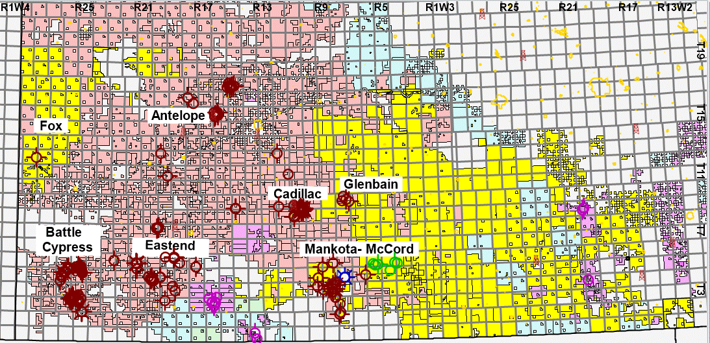


HEVI Land Holdings
275 miles
Fox/Abbey
North American Helium
Royal Helium
Global Helium
130 miles
TARGET AREA
TSXV : HEVI
| 6

Slide 7
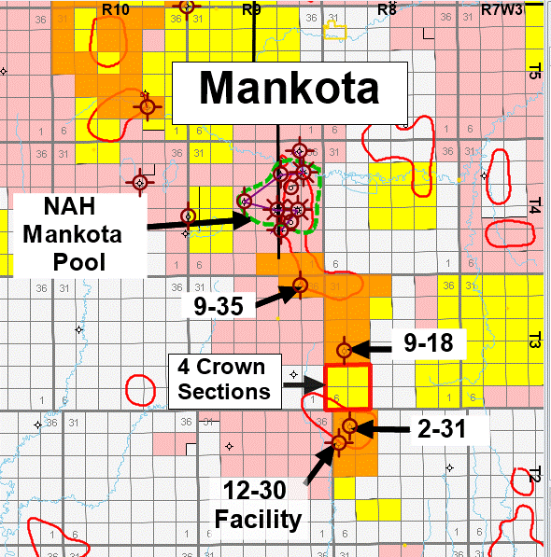
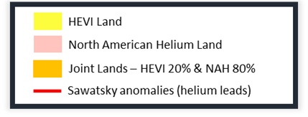
Mankota
  HEVI lands are adjacent to NAH’s producing Mankota pool
  NAH has drilled 18 wells¹ in the Mankota area since 2021
  HEVI recently acquired an additional four sections of 100% land (“4 Crown Sections”) that was previously unleased and is adjacent to existing HEVI and NAH development in the Mankota area
  Three Major Catalysts:
    2-31 well²
    HEVI’s first helium discovery confirmed in November 2023
    9-18 well²
    Second helium discovery, stimulated in July 2024
    9-35 well²
    Third helium discovery; flow tested at 7 MMscf/d
¹ Source – Accumap
² Working interests of NAH 80% and HEVI 20%
TSXV : HEVI
| 7

Slide 8
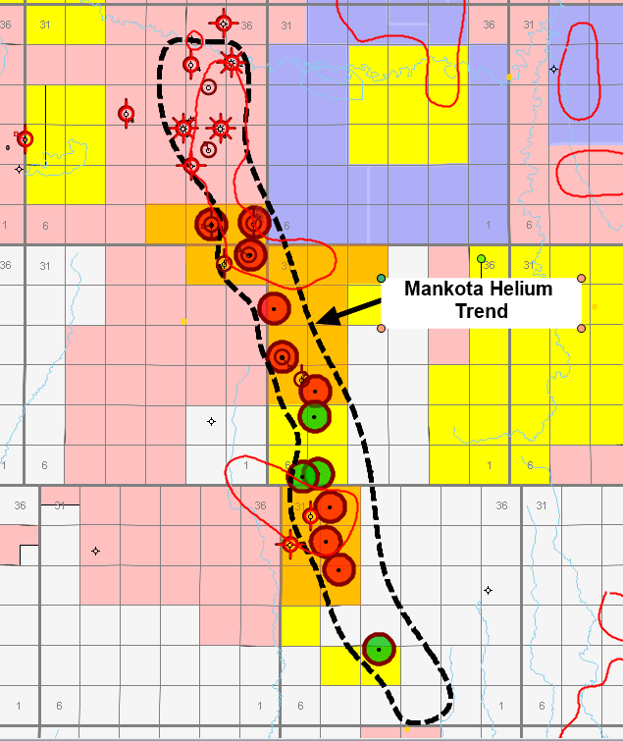
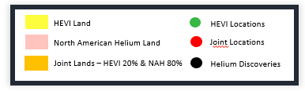
Ambitious Development Drilling Program
  Up to 9 joint drills planned for Q4/24 to 1H/25 (HEVI 20% WI)
  Location selection by NAH aligns with HEVI’s internal technical work
  Drilled to date / announced:
    7-2 well – spud Q4/24; cased for evaluation
    10-1 well – spud Q4/24; 0.75% He, 9.5 MMscf/d flow rate
    10-36 well – spud Q1/25; 0.81% He, 11.5 MMscf/d flow rate
    5-30 well – spud Jan/25; results pending
    12-29 well – spud Jan/25; results pending
    3-19 well – anticipated to spud on or around Feb 7/25
  4 additional locations identified on HEVI 100% owned lands
    HEVI capital commitment¹
    $3.6 to $5.5 million
10-1
10-36
9-35
5-30
3-19
5-17
9-18
2-31
12-29
TSXV : HEVI
¹ Based on HEVI internal estimates
| 8

Slide 9
2-31 Helium Discovery
  Initial Results
  First helium discovery at 2-31 joint well (NAH 80% and HEVI 20%)
  confirmed in November 2023
    Initial flow test of 1.3 MMscf/d and 6,000 kPa flowing tubing pressure
    A 3rd party pressure transient analysis suggested the deliverability could potentially increase by 3-5x with stimulation
  Stimulation Results
  Successfully stimulated in February 2024
  Deliverability increased to 4 MMscf/d with initial 3-day flow test
  Next Steps
  Development well scheduled for upcoming winter months, subject to surface and environmental restrictions
  NAH has licensed a helium plant at 12-30 location for area production
~4.0
MMscf/d flow rate¹
0.95%
Helium
¹ Subsequent to stimulation at 5,500 kPa
TSXV : HEVI
| 9

Slide 10
9-35 and 10-1 Wells (NAH 80% & HEVI 20%)
  9-35 Initial Results
  Second helium discovery at 9-35 well
    Following perforation, well flow tested at 7,000 Mscf/d and 9,000 kPa flowing tubing pressure after a 6-day flow test
    Pressure transient analysis revealed no reservoir pressure depletion or reservoir boundaries and AOFP of 13.3 MMscf/d
  Next Steps
  Delineation wells expected to be drilled in Q4/24 to Q2/25
~7.0
MMscf/d flow rate
0.64%
Helium
  10-1 Initial Results
  9-35 delineation helium well drilled in Q4/24
    Following perforation, well flow tested at 9,500 Mscf/d and 10,800 kPa flowing tubing pressure after a 4-day flow test
    Pressure transient analysis revealed no reservoir pressure depletion or reservoir boundaries and AOFP of 26.0 MMscf/d
    Confirmed pressure communication between 10-1 and 9-35, further supporting potentially large, continuous reservoir
~9.5
MMscf/d flow rate
0.75%
Helium
TSXV : HEVI
| 10

Slide 11
10-36 Well (NAH 80% & HEVI 20%)
  10-36 Initial Results
  9-35 delineation helium well drilled in Q1/25
    Following perforation, well flow tested at 11,500 Mscf/d and 13,100 kPa flowing tubing pressure after a 5-day flow test
  Next Steps
  14-day shut-in period and evaluation of results
~11.5
MMscf/d flow rate
0.81%
Helium
TSXV : HEVI
| 11

Slide 12
9-18 Well (NAH 80% & HEVI 20%)
  9-18 Initial Results
  Third helium discovery at 9-18 well
  Following stimulation in July 2024, well flow tested at 685 Mscf/d and 690 kPa flowing tubing pressure
  Positive strategic and geological advancements
  Next Steps
  Delineation wells expected to be drilled in Q1/25 to Q2/25
0.87%
Helium
TSXV : HEVI
| 12

Slide 13

Path to First Helium Sales
  Agreement in place between NAH and HEVI allowing HEVI to pay processing fees, based on an industry standard calculation, at NAH facilities without committing upfront capital
  Agreement also allows HEVI to take helium in kind or HEVI can participate in NAH’s marketing arrangements for a 2.5% fee
  NAH has licensed a facility at 12-30, adjacent to the 2-31 commercial helium discovery well
    Final investment decision to be made subsequent to further delineation of the helium pool
TSXV : HEVI
| 13

Slide 14
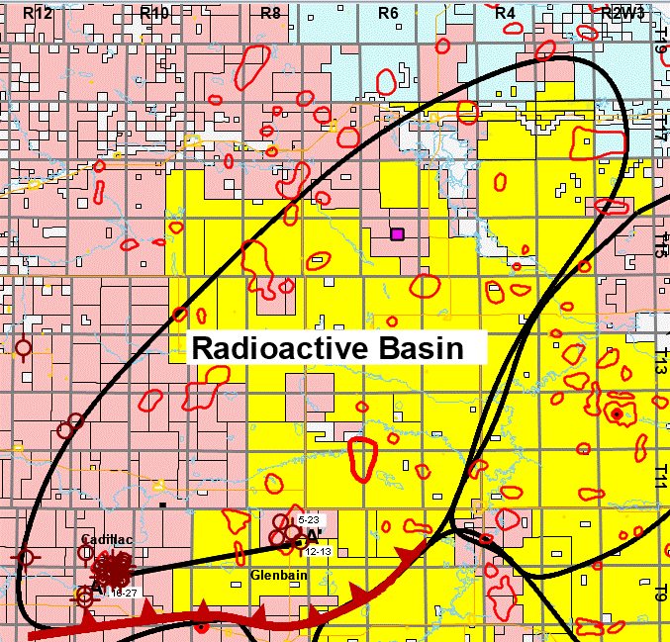
Gravelbourg / Glenbain
  HEVI’S internal interpretation suggests that numerous targets on HEVI’s land display similar characteristics to the NAH Cadillac producing pool
  12-13 well drilled in Q3/23
    Cased for further evaluation
  Generating Internal Targets:
    Seismic interpretation underway which may result in additional prospective locations
    Multiple drillable locations identified
HEVI Land
North American Helium Land
Joint Lands – HEVI 20% & NAH 80%
HEVI seismic
Sawatsky anomalies (helium leads)
TSXV : HEVI
| 14

Slide 15
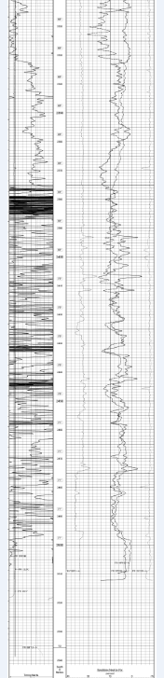
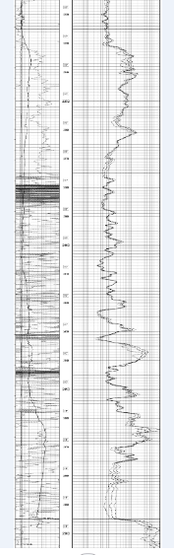
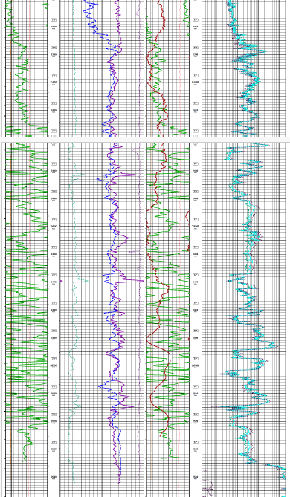
Gravelbourg / Glenbain - Middle Deadwood
NAH 16-27-9-11W3
NAH/HEVI 12-13-10-8W3
Stratigraphic X-section
Thick middle deadwood with pay zone 40+m
Radioactive zone
helium source rock
Gas Pay
Zone
Radioactive
Zone
PreCambrian

Slide 16
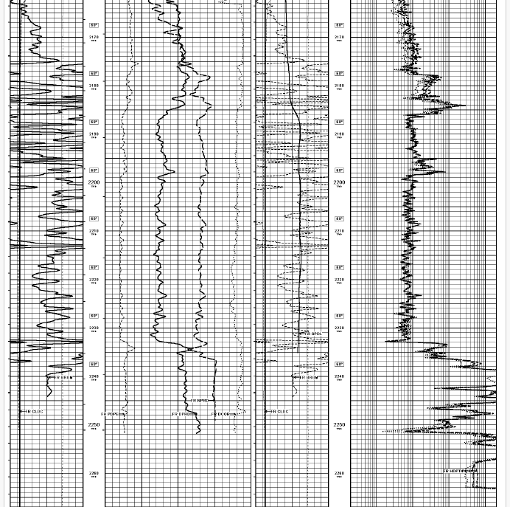
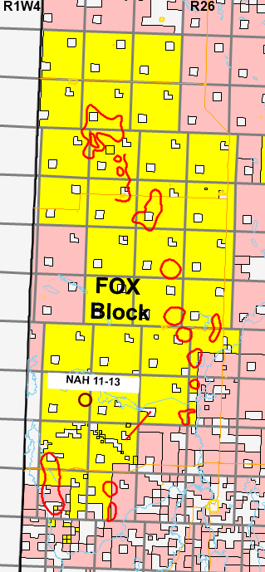
Fox/Hatton
  11-13 well drilled in Q3/23
    True wildcat well; first well drilled in the area in ~70 years
Thick Basal sandstone
of 58 meters
Intermediate cased for potential reentry
Potential drillable locations identified
Basal Sandstone
PreCambrian
HEVI Land
North American Helium Land
Joint Lands – HEVI 20% & NAH 80%
Sawatsky anomalies (helium leads)

Slide 17
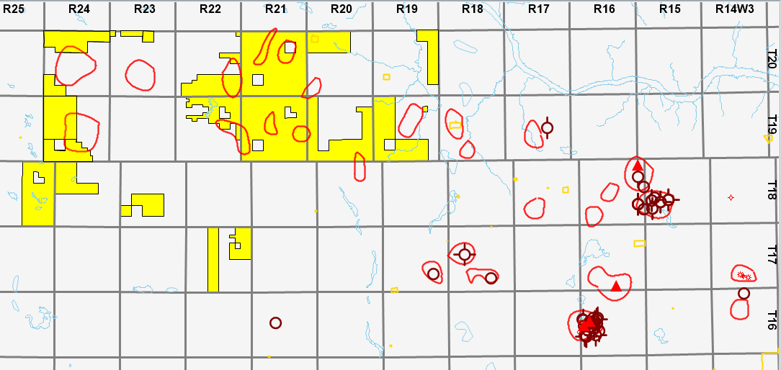
Fox/Abbey
Area is becoming increasingly more prospective given recent wells drilled on neighbouring land
High Helium content of up to 2%
Numerous potential targets based on historical Sawatsky anomalies
HEVI Land
NAH wells drilled for Helium
New Helium well licenses
Sawatsky anomalies (helium leads)

Slide 18

Economic Assumptions
$600/mcf
4,000 mcf/d
$2.0MM
$1.55MM
USD commodity price
Raw gas production
Drilling costs
Completion,
equip & tie-in
0.95%
4.25%
10year
Helium concentration
Crown royalty
Well life
| 18

Slide 19
Development Plan Economics*
Inclusive of the three recent Helium discovery wells
 | Low | Mid | High
Wells drilled (gross) | 9 | 12 | 16
Successful wells (gross) | 6 | 8 | 10
Successful wells (net) | 1.2 | 1.6 | 3.6
Net capital ($MM) | 5.1 | 6.9 | 34.0
Helium sales (mcf/d) | 41 | 55 | 123
Cash flow from operations ($MM/year) | 8.7 | 11.7 | 28.7
NPV BTAX @10% ($MM) | 38.8 | 51.6 | 110.3
IRR | 170% | 170% | 80%
Payout (years) | 0.6 | 0.6 | 1.2
*Economics shown above are calculated based on certain assumptions and do not represent guaranteed success rates, IRR, payout or NVP.
TSXV : HEVI
| 19

Slide 20





Near-term Growth Trajectory
Helium Evolution is executing on a strategically defined path to value creation.
FIRST HELIUM DISCOVERY AT MANKOTA
9-35 WELL EXPANDS MANKOTA DISCOVERY
STIMULATION OF
9-18 WELL AT MANKOTA
OFFSET DRILLING/ ADVANCING FACILITY CONSTRUCTION
GOAL OF COMMERCIAL PRODUCTION
DRILLED 11 WELLS
7 cased and 4 D&A
2022–2024
Q4 2023
Q1/Q2 2024
Q3 2024
Q4-2024/25
2025
NEAR TERM CATALYSTS
:
Development of Mankota helium discoveries – up to 9 follow up locations to be drilled with NAH in Q4-2024 to 1H-2025
PROJECTED HELIUM SALES
in 2025

Slide 21
Appendix

Slide 22
A Growing Need for Helium
There are no substitutes for Helium, and it cannot be synthesized
Helium Global Demand by Market Segment (2023)¹
Demand Forecast by Segment¹
2021¹
¹ U.S.G.S, company reports and Peters & Co. Limited
TSXV : HEVI
| 22

Slide 23
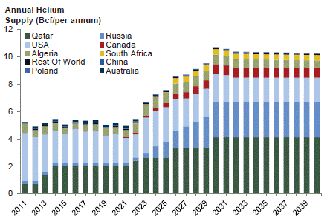
The New Market Landscape
Continental North American supply of helium has significantly weakened with the sale of the U.S. strategic reserve
Geopolitical issues – Russia, Middle East sources
As the helium market continues to evolve, greater transparency into market pricing for helium is expected
Supply by Region³
Pricing Reported by Industry Competitors^{1,2}
~$625
~$1,100
USD per mcf wholesale
helium pricing
USD per mcf retail helium pricing
RESULT
Pure-play Canadian helium development is now economically viable and deemed critically important for Canada’s economic development.⁴
¹ Royal Helium May 26, 2023 News Release
²NASA news release dated September 29, 2022
³US.G.S, company reports and Peters & Co. Limited
⁴Critical Minerals; Government of Canada; 2021
TSXV : HEVI
| 23

Slide 24

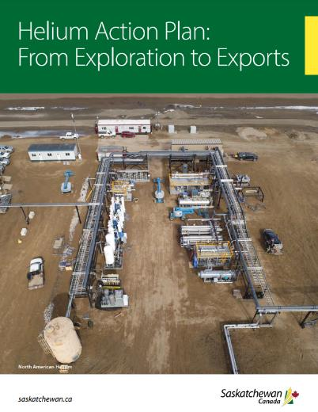
HEVI’s Saskatchewan Advantage
ESG-friendly: green source of helium as harmless nitrogen gas is carrier
Stable, safe & environmentally responsible vs other global jurisdictions
Proximity to high-demand U.S. markets and existing infrastructure
Identical drilling process to natural gas & access to skilled labour
21yr
4.25%
10%
lease terms; drilling not
required to maintain permits
net provincial royalty rate
of global market share for helium targeted by 2030 as committed to by the SK government
¹ Emerging Ideas, Industrial Technology: Helium; Cormark Securities; 2020
² Helium in Southwestern Saskatchewan: Accumulation and Geological Setting; Melinda Yurkowski; 2016
TSXV : HEVI
| 24

Slide 25
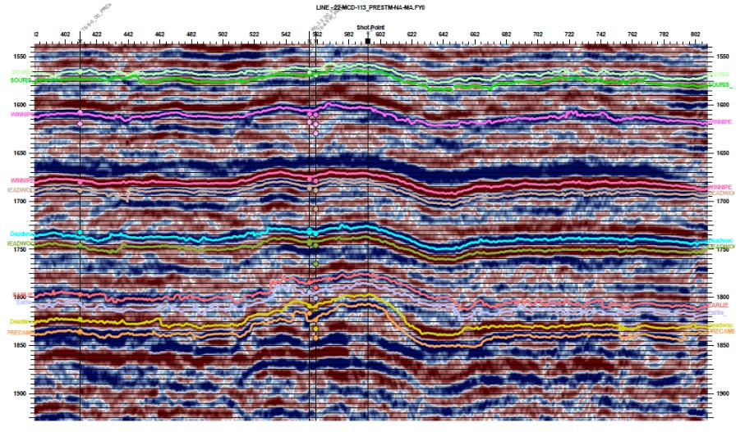
Earlie Sandstone Structural Play

Slide 26
An Experienced Team
Extensive resource development expertise with a history of success in Saskatchewan
Greg Robb, Co-Founder
President, Chief Executive Officer, and Director
John Kanderka, Co-Founder
VP, Land & Corporate Development
Geologist with over 35 years of experience across all facets of Western Canadian energy resource activity including exploration and development, A&D and reserve valuations.
Over 40 years in the energy and mineral sectors as both an officer and director of private and public entities.
Management
Patrick Mills, P. Eng, Co-Founder
Chief Operating Officer
Kristi Kunec, CPA(CA)
Chief Financial Officer
Over 35 years of executive, managerial, and engineering & operational experience in the Western Canadian Sedimentary Basin.
Over 20 years of experience as Controller & CFO for various growing public and private resource companies.
James P. Baker, Co-Founder
Chairman & Independent Director
Brad Wall
Independent Director
Over 40 years of resource development experience in Saskatchewan and Alberta in field operations, consulting, executive level and board positions.
Former Premier of Saskatchewan, leading the province through record population and economic growth, export expansion, infrastructure investment, and securing a AAA credit rating.
Michael Graham
Independent Director
Philip Hughes, CPA(CA)
Independent Director
BOARD OF DIRECTORS
Independent businessman with over 35 years of energy and resource development experience, former Executive Vice President of EnCana Corporation and as President of the Canadian division of the company.
Over 35 years of Canadian energy experience serving as President and CEO of five energy companies across Canada. Currently Chairman of Oceanic Wind Energy Group and Kineticor Resources Inc.
Jeff Barber, CFA
Director
Heather Isidoro, P.Eng., MBA
Independent Director
Seasoned investment professional who co-founded a boutique M&A advisory firm in Calgary and was an investment banker prior thereto.
Over 20 years of experience in the energy industry, bringing a broad range of experience with specialization in A&D, reserves valuations, and financial modeling.
TSXV : HEVI
| 26

Slide 27

Developing Canada’s Helium Resources
Corporate Presentation
February 2025
Contact
info@heliumevolution.ca
TSXV : HEVI

